Slide 1
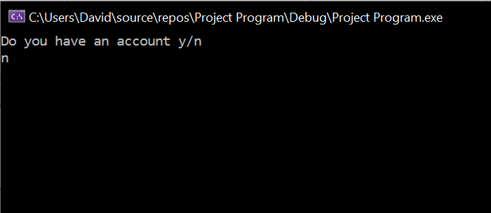
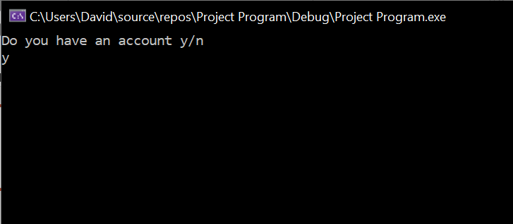
At the start of the code you will be asked if you have an account. The options available are either yes(y) or no(n)
If you select no(n) you will be asked to create a user name and password.
If you select yes(y) you will skip this and be asked to enter you username and password.

Slide 2
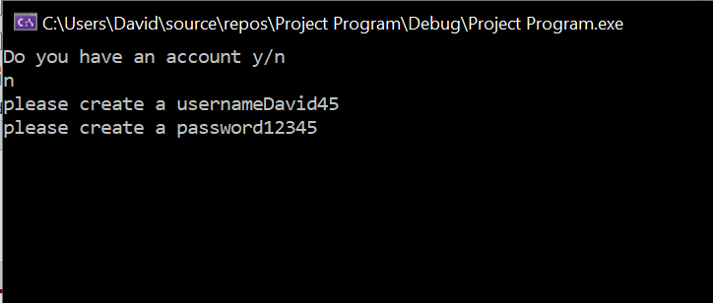
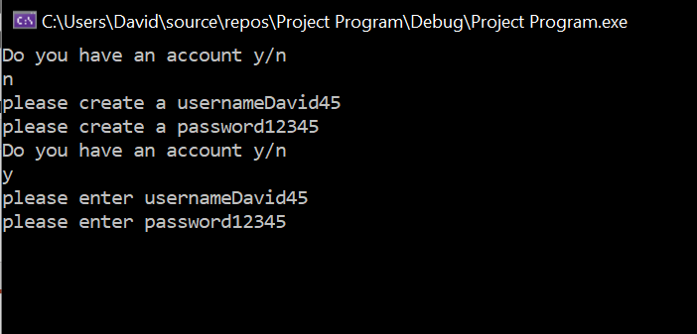
Here I am creating a username and password after selecting the no option to the account question. These will be encrypted onto a text file.
After entering a username and password the code takes you back to the beginning. Here I have answered yes(y) and am not entering the username and password I have just made. If these are incorrect the code will take you back to the beginning where you will be asked again if you have an account or not.

Slide 3
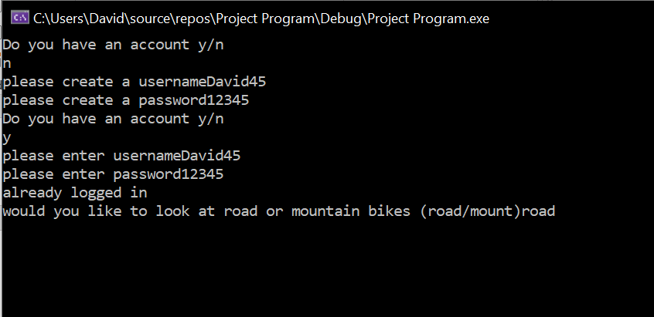
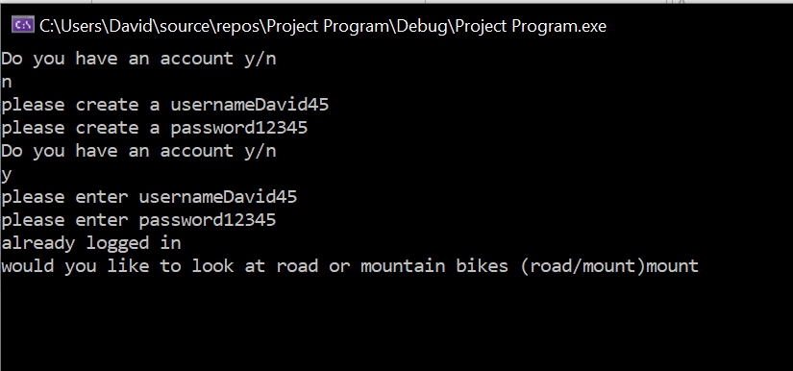
Once successfully logged in the user is given the option to enter either road or mount to select either mountain bikes or road bikes to look at. Depending on the input made here the correct file will be accessed.

Slide 4
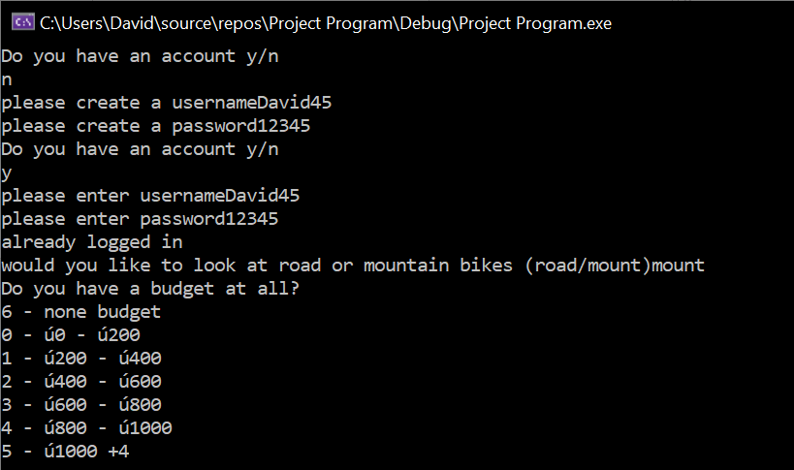
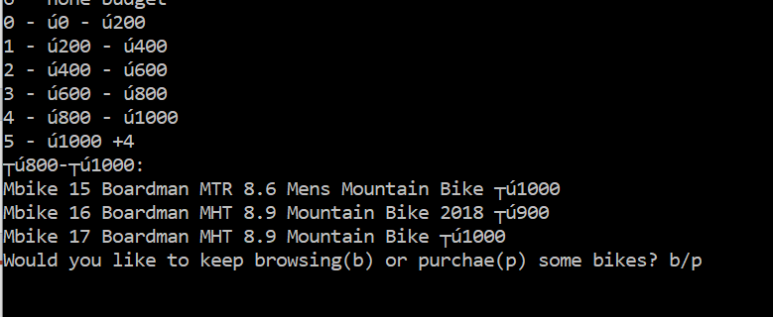
Once this is inputted the user then needs to input a budget for the bikes they want to look at.
This can be entering numbers from 0 to 6. the key is printed.
The bikes displayed will depend on the number inputted. Here the number 4 was inputted which is for bikes between £800 and £1000
Once the bikes are outputted you have the option to either keep browsing(b) or purchase(p) some of the bikes. If the user wants to keep browsing(b) it will take them back to the road/mount input.

Slide 5
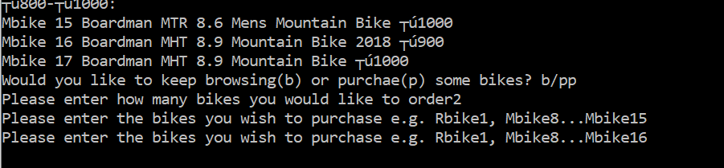
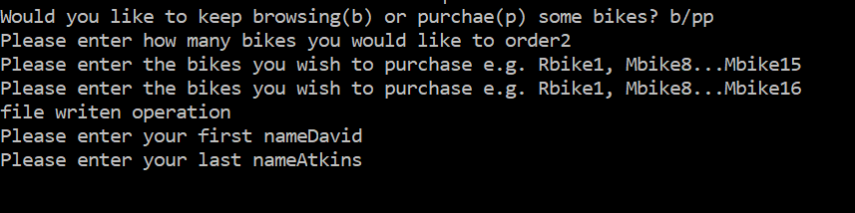
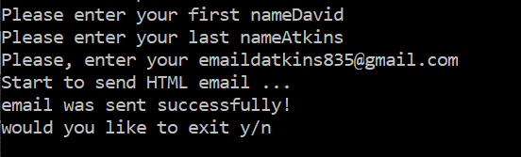
After selecting purchase(p) they are asked to enter the number of bikes they wish to order.
It will then ask them to enter the bikes they wish to get, looping the same amount as they wished to order.
A message confirms the orders have been seen.
The user is then asked to enter their name and second name for messages used in the code.
The email address of the user is then inputted so the email can be sent. If the email is sent a message will confirm it being sent.

Slide 6
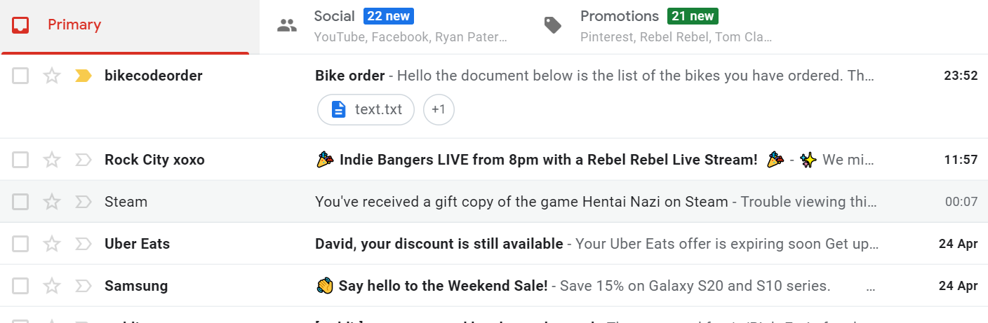
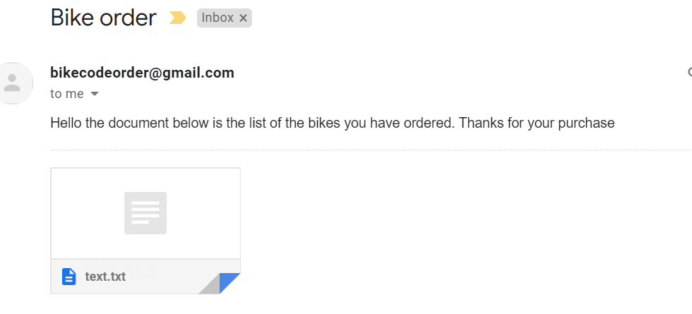
This image shows my email and the bike code email in the inbox. Attached to the email will be a text file with the orders in.
The bottom image shows the email itself with the message and text file.

Slide 7
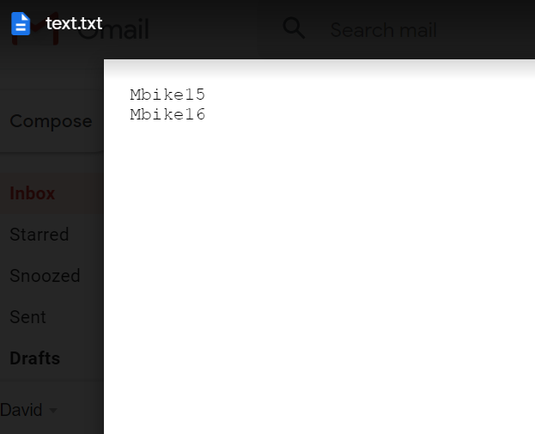
This image shows the content of the text file and the bikes which we ordered earlier in the code.

Slide 8

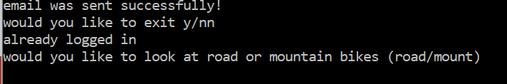
After the email section of the code the user is asked if they wish to exit the code or not. Yes(y) or no (n)
If they select yes(y) they will exit the code straight away. If they enter no(n) they will loop back to the beginning of the code. They will skip the account section as they will already be signed in.

